Slide 1
Machine Learning with python video 12
Simple Linear Regression

Slide 2
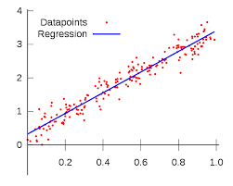
What is simple Linear Regression
It is the simplest form of regression. The relationship between the dependent variable and independent variables is assumed to be linear in nature When
you have only 1
independent variable
and 1 dependent
variable, it is called
simple
linear regression.

Slide 3
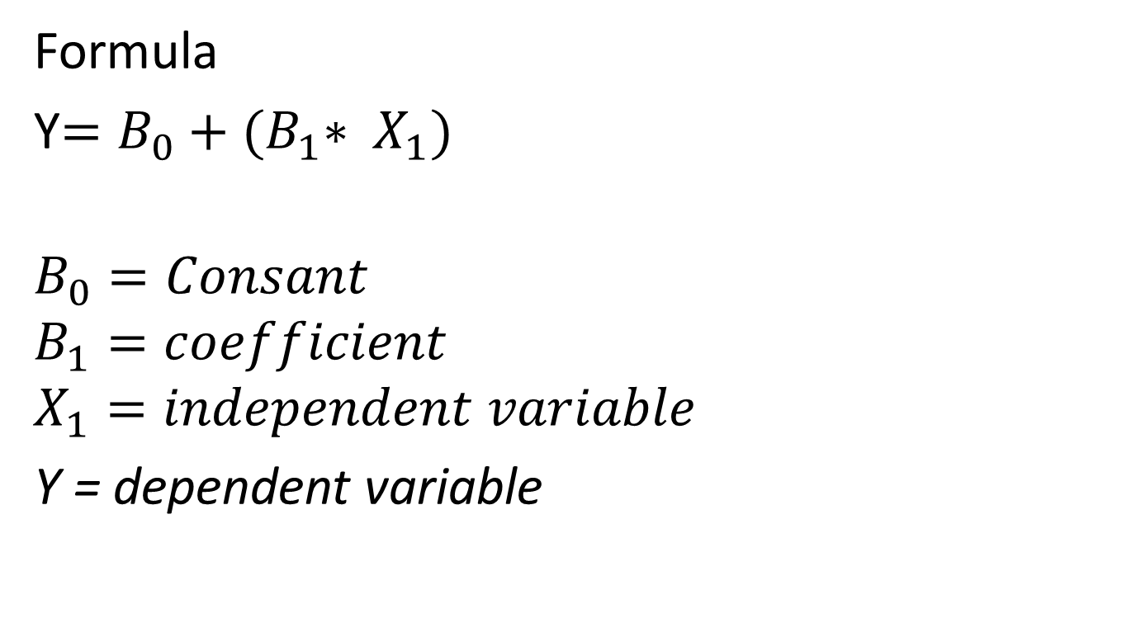
Formula
Y$=B_{0}+{(B}_{1}∗ X_{1})$
$$B_{0}=Consant$$
$$B_{1}=coefficient$$
$$X_{1}=independent variable$$
Y = dependent variable

Slide 4
Points to understand
Constant is output when the independent value is zero
if slope is more per unit output change is also more
if slope is less per unit output change is also less

Slide 5

Best fitting line
Lets say Y is actual output and Ὗ output predicted by our model
So to get the best fit line
SUM(Y - Ὗ)$^{2} =$min

